Slide 1
TITLE SLIDE

Slide 2
3 steps to start a Primary 2 picture composition
Step 1 – When did the story take place? a) Look at Picture and think of a realistic day and time that the scene could happen. ...
Step 2 – Where did the story take place? ...
Step 3 – What was the main character doing at the start of the story?

Slide 3
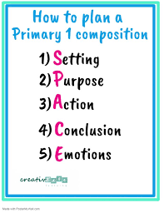
The first step is to know the story structure – what are the important story elements that each composition must include.
With Primary 1 pupils, the SPACE planning strategy is a simple yet effective planning tool for pupils to understand the planning of story structure.

Slide 4
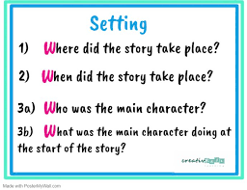
Using the ‘W’s , the setting tells the reader the the time (When), place (Where) and main character (Who) of the story.
.

Slide 5
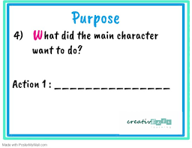
It is important to understand that composition writing goes beyond picture description.
This is the part the child need to tap on their imagination and see beyond the pictures to form a story.
In this case, think of a possible reason that the main character was queuing up.

Slide 6
A purpose leads to an action.
This means that when the main character wanted to do something, it will lead to an action happening,

Slide 7
A complete story requires a conclusion which tells the reader what happened at the end of the story as well as the lesson learnt.

Slide 8
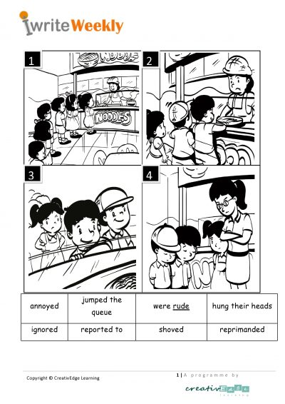

Slide 9
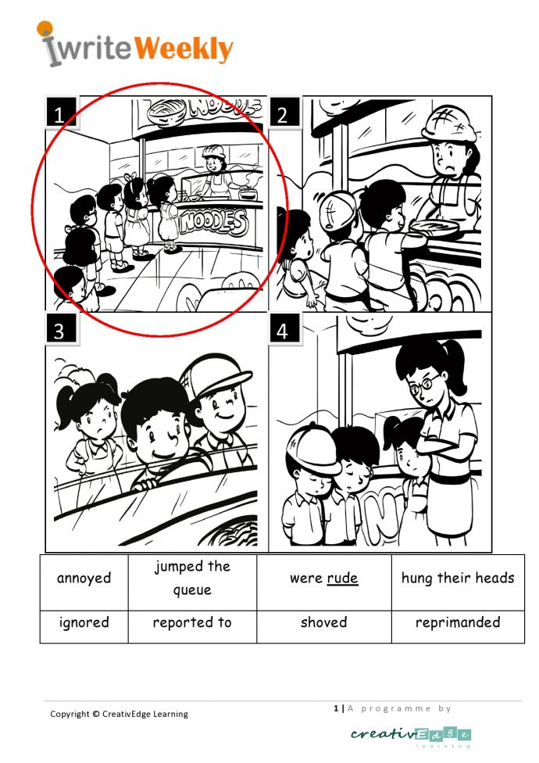

Slide 11
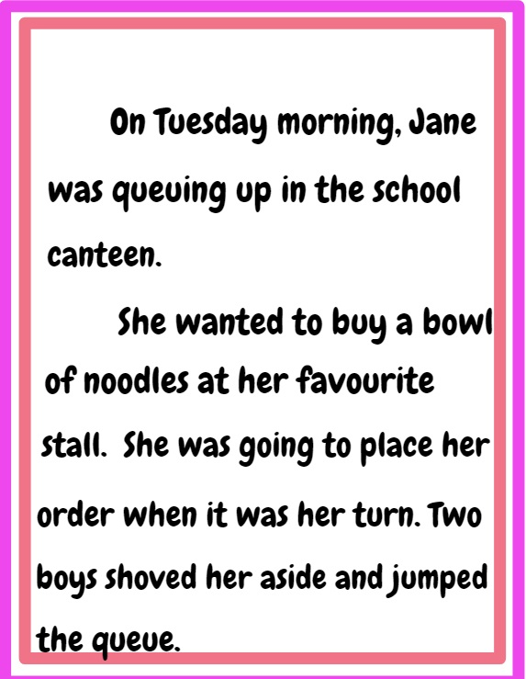

Slide 14
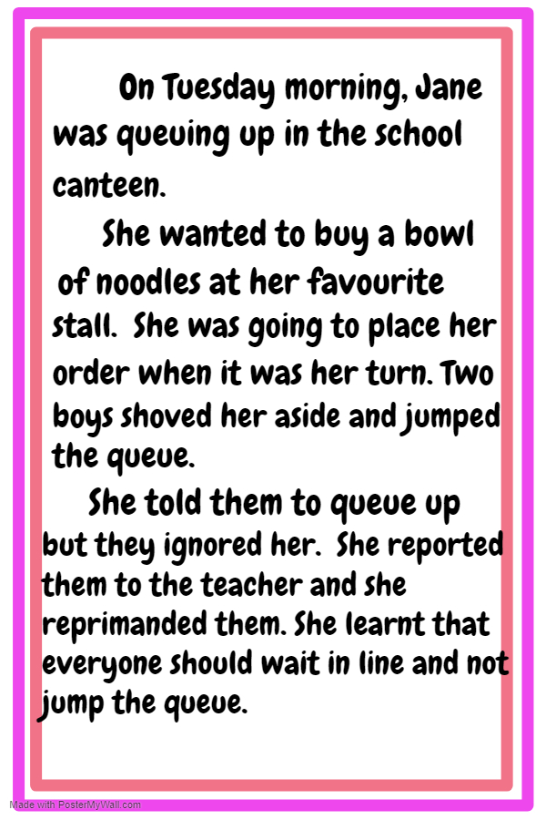

Slide 15
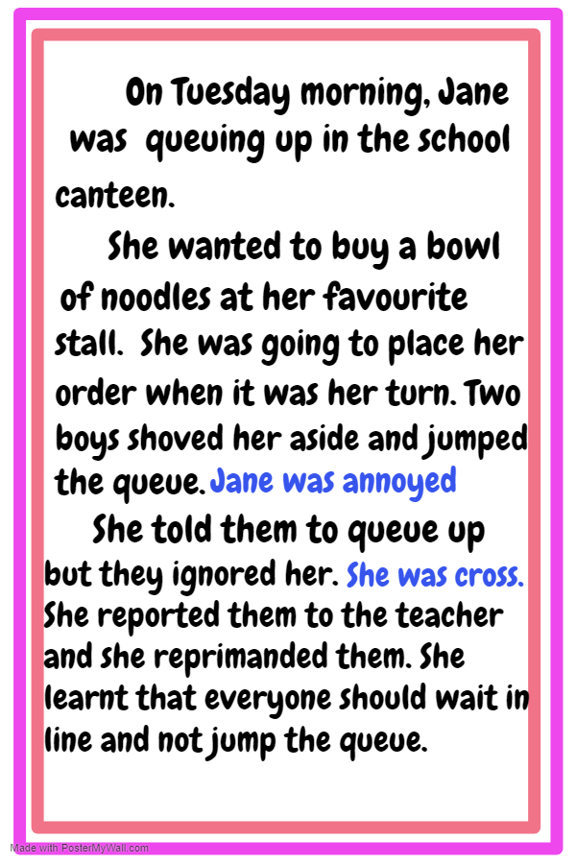
E FOR EMOTIONS
Now that the entire story is complete. The emotions (feelings) of the main character can be inserted to complete the story.

